Slide 1
An Advanced Approach on Predictive Modelling of Traffic Violations
Divya Jayaprakash Mayank Kothari
Shamsundar Kulkarni Vijay Shankar Balaji
Gautami Murugan

Slide 2
Project Contents
Traffic Violation dataset
Predicting whether the traffic violation will contribute to accident
SEMMA Process in SAS EM
Goal of improving prediction results
Present managerial – relevant findings

Slide 3
Objective
The main objectives of our project are:
Explore and analyze the perspective input parameters that impact the factors contributing to traffic violations involving accidents.
Explore different data mining techniques to predict whether the traffic violation will contribute to an accident or not.
“In God we trust, all others must bring data”
- W. Edwards Deming

Slide 4
BI Model
Data Analysis
Data Collection
Data
Cleaning
Managerial
conclusion
Descriptive Statistics
Predictive Modelling

Slide 5
Data Set Description
The data set used in this analysis is a second-hand dataset obtained from data.gov.
These data of traffic violations in Montgomery county of Maryland, from the U.S. government, can be used to predict whether the traffic violation would contribute to an accident, contribute to property damage or personal injury.
The data set consist a total of 825297 records with 35 parameters.

Slide 6
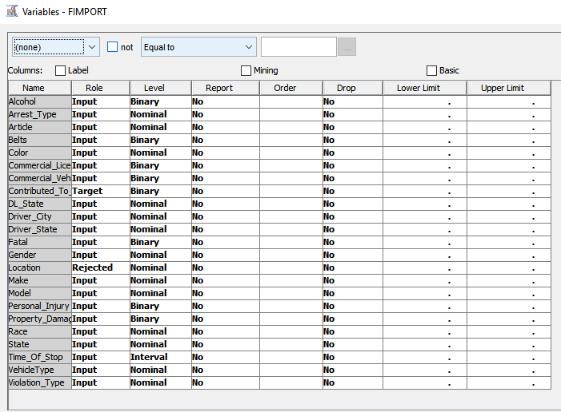
Variables

Slide 7
Cleaning and Preprocessing of Data
Our dataset is mainly categorical with the target variable values being ‘yes’ or ‘no’.
Different Data sets for Training and Validation.
For Training Data:
Oversampled -> Rare Events
Undersampled -> Frequent Events
For Validation Data:
Random Data in same proportion.

Slide 8
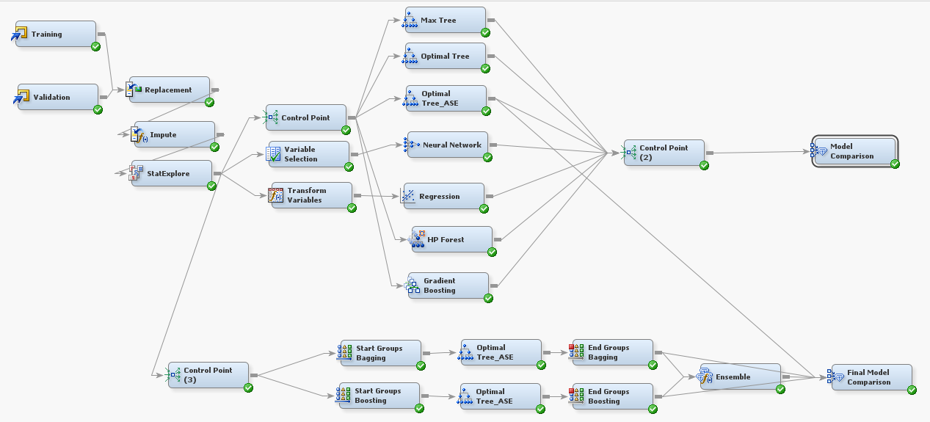
Enterprise Miner Diagram

Slide 9
Replacement Node
Few variables in the data set were not recorded properly, for which we used the replacement node.
For Example: we replaced,
‘Ye’ to Yes
_UNKOWN_ to _DEFAULT_
Green, to Green
Blue, to Blue

Slide 10
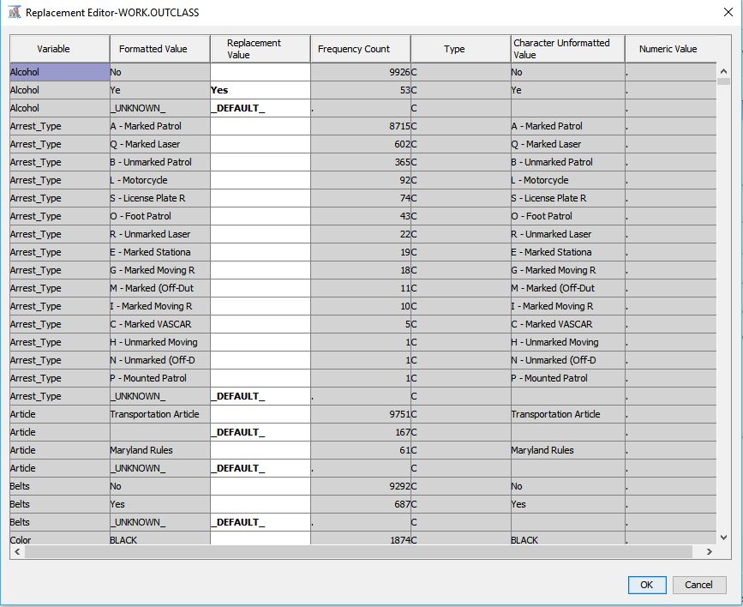
Replacement Node

Slide 11
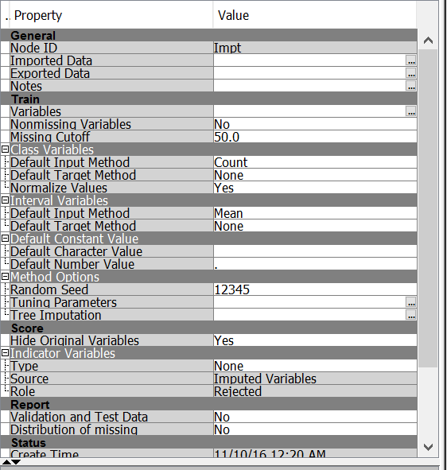
Impute Node
On exploration, it was found that some variables had missing values. We use the Impute node to populate the missing values. Below are the input methods for class and interval variables’ imputation:
Class Variables: Default Input Method – Count
Interval Variables: Default Input Method – Mean

Slide 12
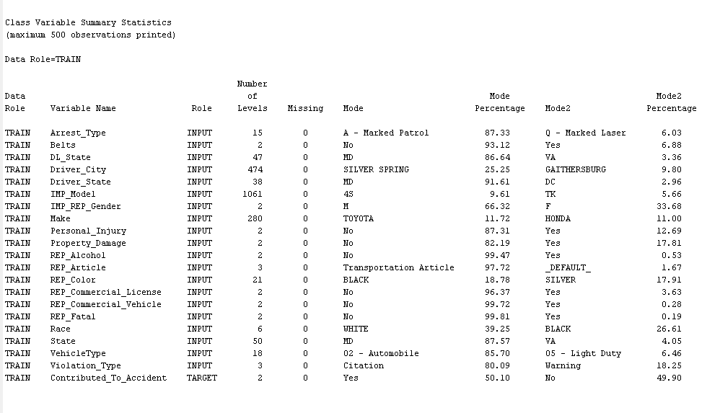
Stat Explore
We have used the Stat Explore node in SAS Enterprise Miner to produce analyze the statistical summary of our data.
From the Stat Explore result we can confirm we don’t have any missing values in the independent input variables used.

Slide 13
Transform Variables
It is known that the normally distributed input variables give accurate results. To avoid the distribution effect on the output, the variables that are extremely skewed are transformed. So, the transform variable node is used before logistic regression.

Slide 14
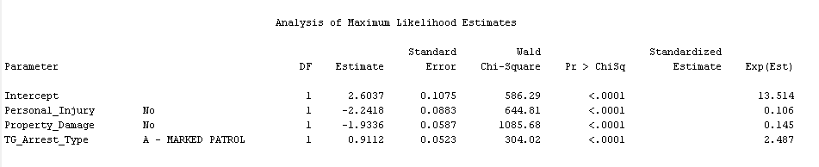
Logistics Regression
Logistic regression measures the relationship between the categorical dependent variable and one or more independent variables.
The variables have p-value <0.0001 which means that they are highly significant carrying a lot of information about the target variable.

Slide 15
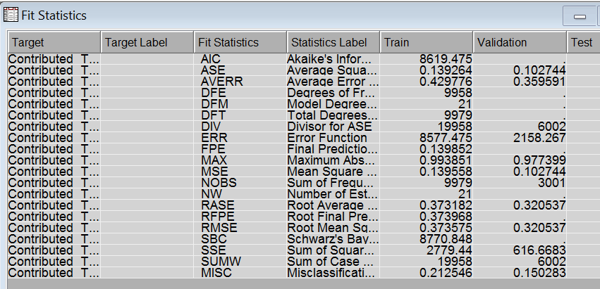
Logistics Regression
We can notice from the Fit Statistics that:
The Misclassification Rate for Train data is 0.212546 and Validation data is 0.150283
The Average Squared error for Train data is 0.139264 and Validation data: 0.102744

Slide 16
Decision tree
Decision tree provides an excellent introduction to predictive modeling. These models are conceptually easy to understand and they readily accommodate nonlinear associations between input variables and one or more target variables. We perform the following models
Max Tree
Optimal Tree - is grown with the ASSESSMENT MEASURE parameter set to “Decision”.
Optimal Tree ASE- is grown with the ASSESSMENT MEASURE parameter set to “Average Square Error”.

Slide 17
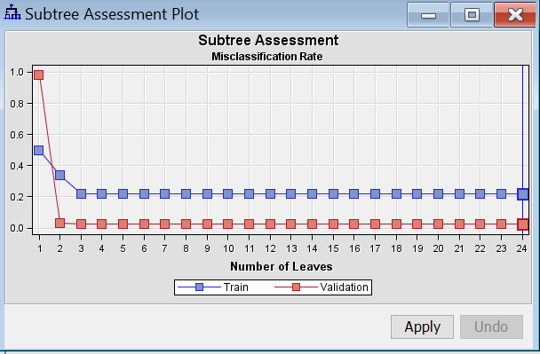
Max Tree- Sub tree assessment plot

Slide 18
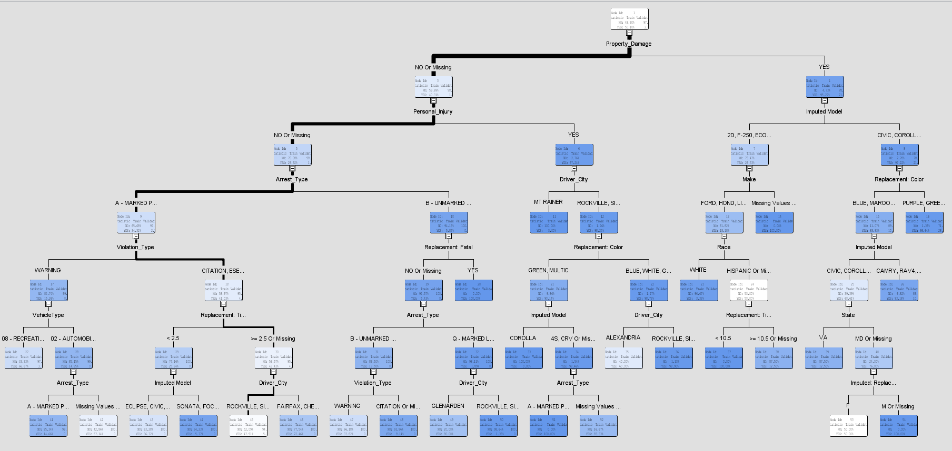
Max Tree- Tree Interpretation

Slide 19
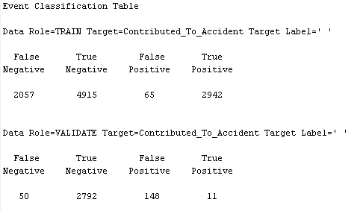
Max Tree Confusion Matrix
The model is good because the False Negative and False Positive counts are very less when compared to the True Negative and True positive counts respectively.

Slide 20
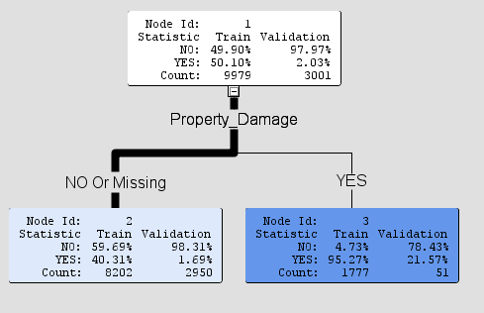
Optimal Decision Tree
Decision tree created setting ASSESSMENT MEASURE = DECISION
Existing Property Damage carries more
information in predicting
whether the accident has
happened or not
Almost a pure node that states that
amongst all traffic violation cases,
the vehicles that had an existing damage,
ended in fatal accident for 21.57% of times

Slide 21
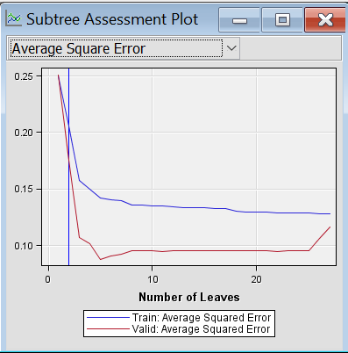
Optimal Tree- Subtree Assessment Plot

Slide 22
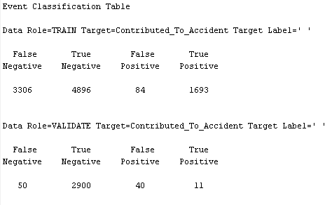
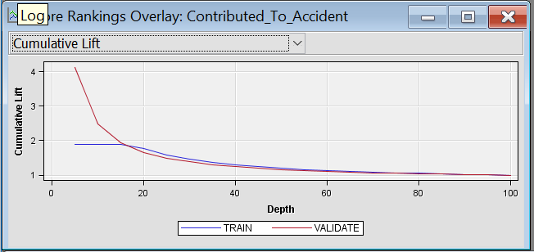
Optimal Tree Confusion Matrix
The model is good because the False Negative and False Positive counts are very less when compared to the True Negative and True positive counts respectively.

Slide 23
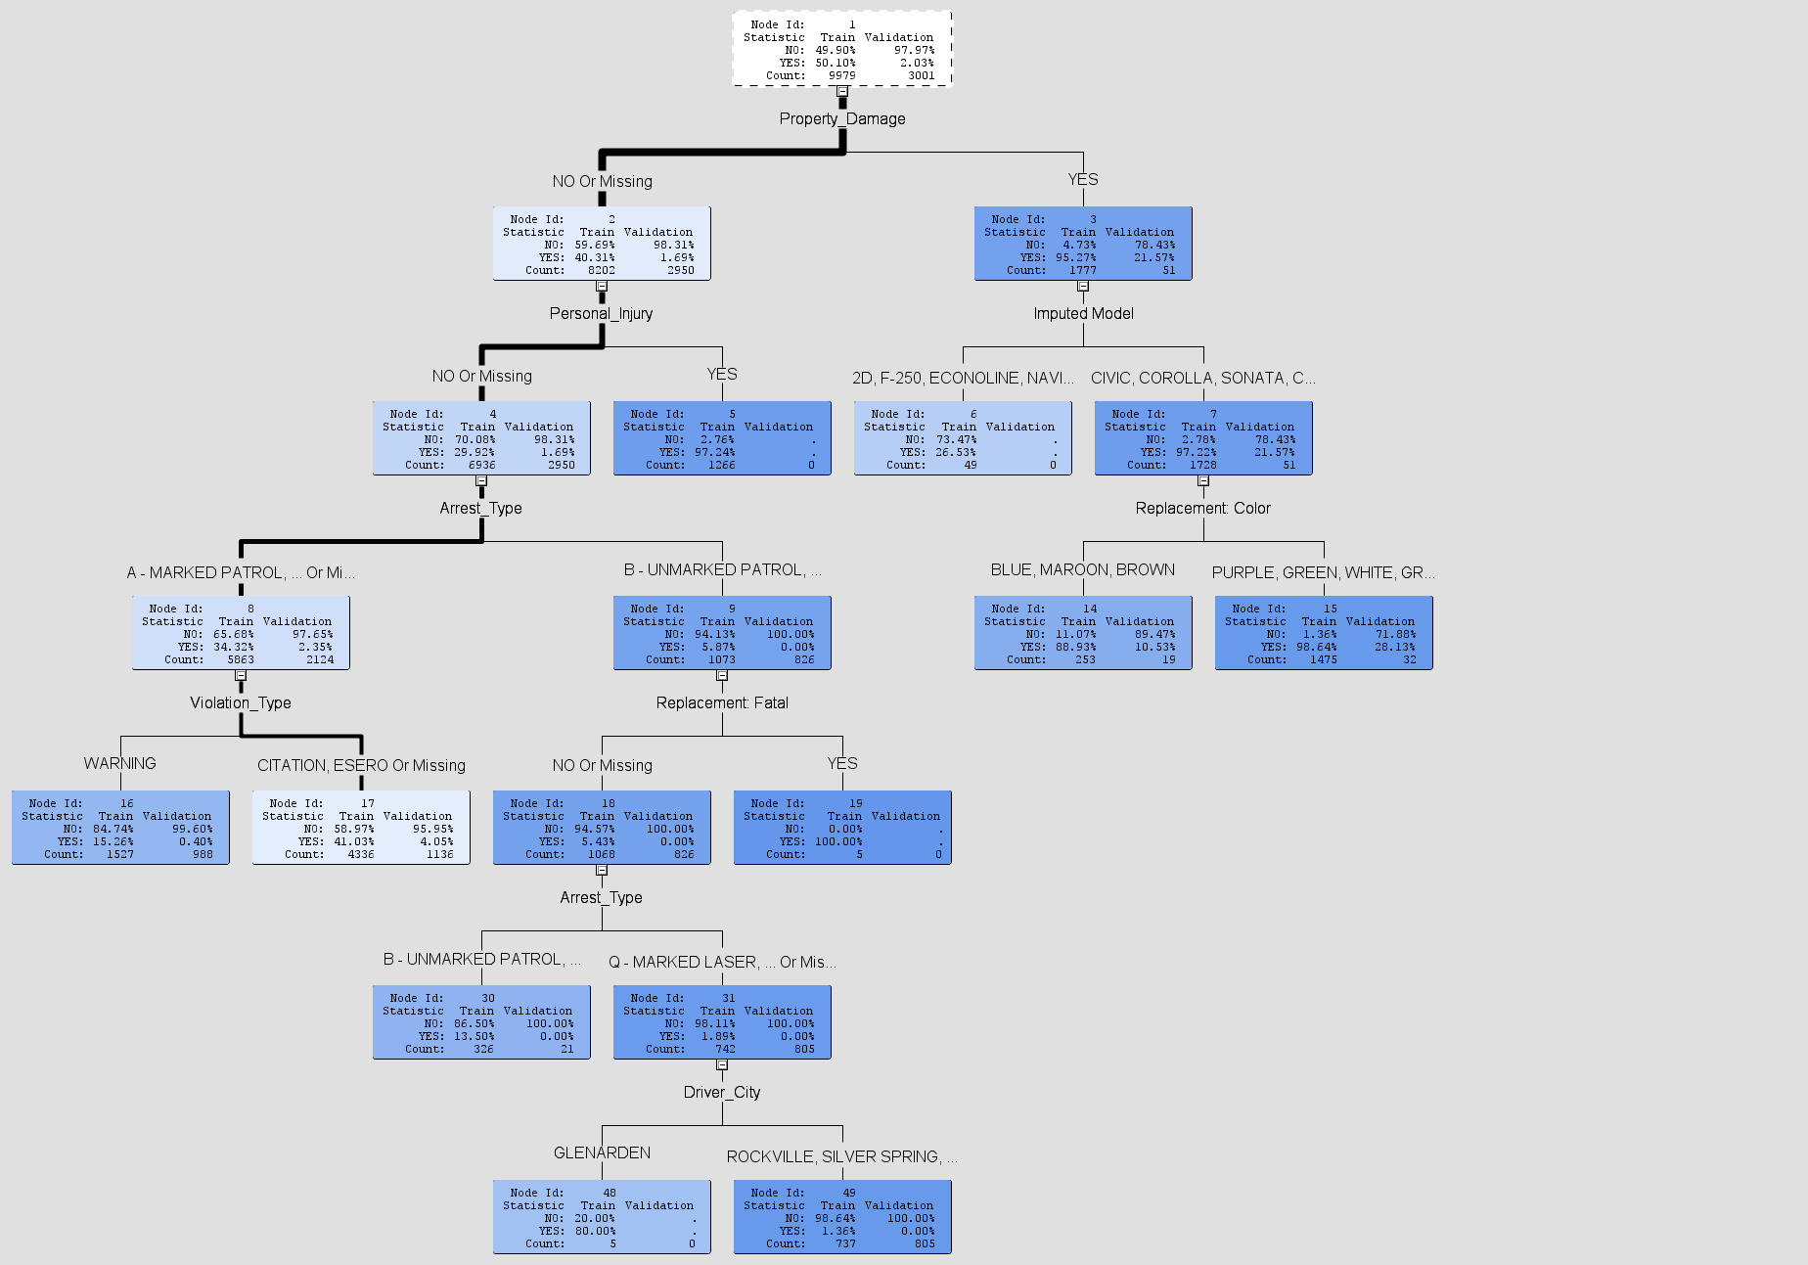
Optimal Tree ASE
These highly informative factors that
occur before accident and contribute to accident
They can be controlled by humans to prevent
accident
Bigger optimal tree : Assessment Measure = ASE
Car model , violation type,
driver city –good predictors of the target variable

Slide 24
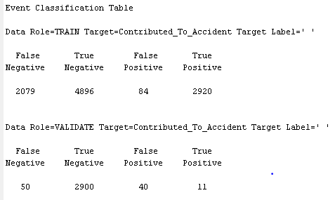
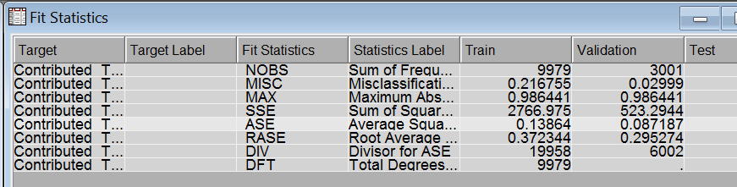
Optimal Tree ASE- Fit Stats and
We can notice from the Fit Statistics that:
The Misclassification Rate for Train data is 0.216755 and Validation data is 0.02999
The Average Squared error for Train data is 0.13864 and Validation data: 0.087187

Slide 25
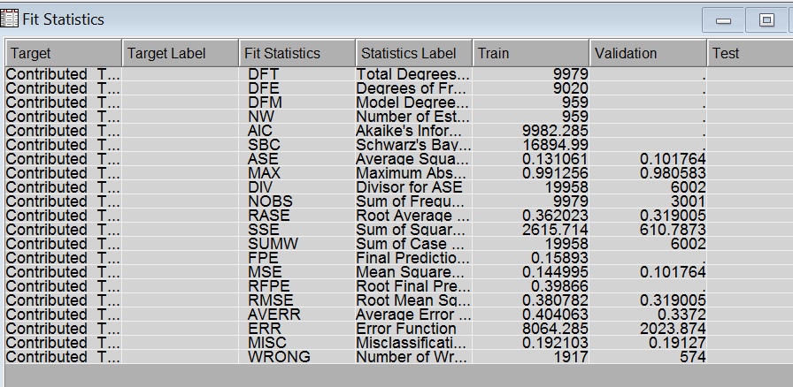
Neural Network
Compared to logistic regression, neutral network can well accommodate categorical predictors and binary target variable which were our biggest challenge
We can notice from the Fit Statistics that:
The Misclassification Rate for Train data is 0.192103 and Validation data is 0.19127
The Average Squared error for Train data is 0.131061 and Validation data: 0.101764

Slide 26
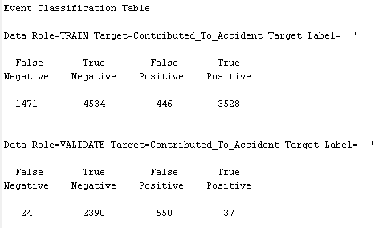
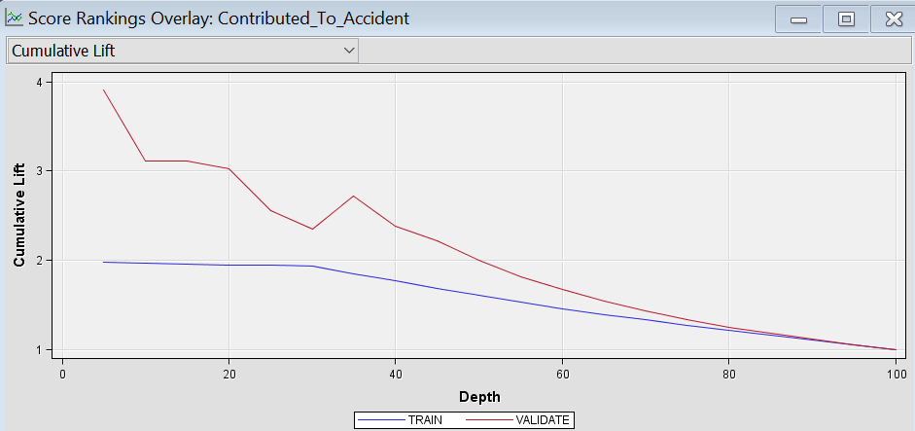
Neural Confusion Matrix and Cumulative lift graph

Slide 27
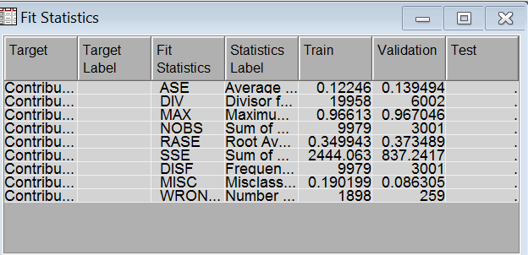
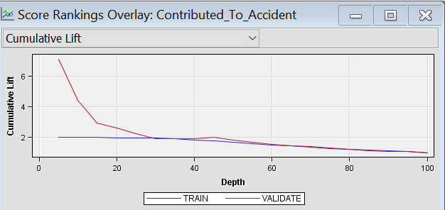
HP Forest
HP Forest is one of the best predictive models for extremely large nominal dataset. It creates several tree forests using random ensemble methodology and combines the predictions by voting for the target variables.

Slide 28
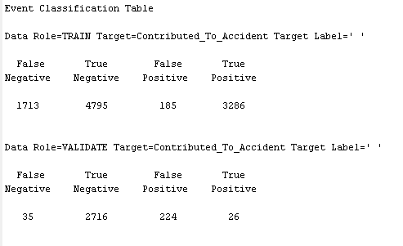
HP Forest
The low misclassification rate and the low average square error showcase that this model is a good model for this categorical dataset.

Slide 29
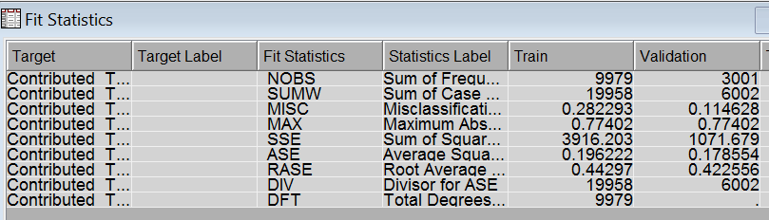
Gradient Boosting
Gradient boosting works on iterative sampling and modelling for the predicted target. In each iteration, the data to be trained is the data correctly classified from the previous iteration.
Misclassification rate:
Train: 0.282293, Validation: 0.114628
Avg. Square Error:
Train: 0.196222, Validation: 0.178554
Good Cumulative lift

Slide 30
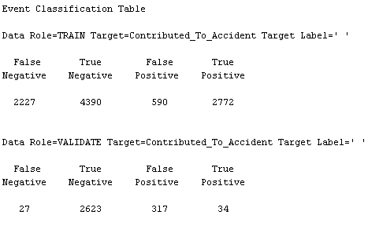
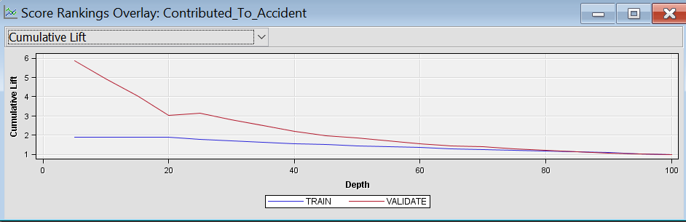
Gradient Boosting

Slide 31
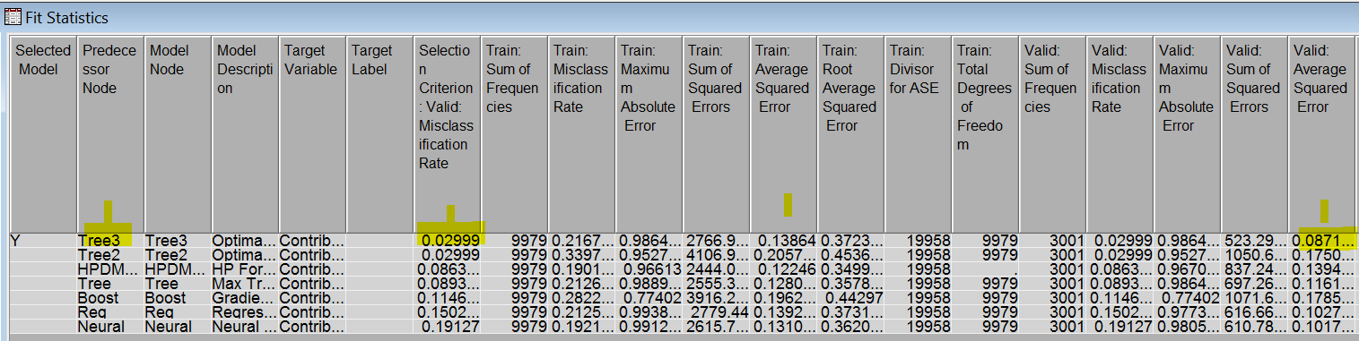
Model Comparison
The Optimal ASE decision tree model of all the predictive models seems to be predicting better with low average square error and low misclassification rate.

Slide 32
Model Enhancement
Ensemble learning is primarily used to improve the ( classification, prediction, function approximation, etc. ) performance of a model or reduce the likelihood
Ensemble models are products of training several similar models and combine their results in order to
reduce bias
reduce variance
improve accuracy
provide robust models in the presence of the new data.

Slide 33
Ensemble Learners
Bagging ( Bootstrap Aggregating )
To create several samples to train models and combine the predicted probabilities.

Slide 34
ML Algorithm - Boosting
Boosting
Like bagging, the boosting uses multiple sampling. But here, the samples are iteratively taken and on each iteration, the misclassification rate is recognized and corrected on its own.

Slide 35
Final Model Comparison
A comparison of the
simple optimal tree ASE,
bagged optimal ASE tree (Best)
boosted optimal ASE tree
Ensemble of bagged & boosted trees
The cumulative lift plot also clearly states that the bagged optimal tree is very good model with very high cumulative lift, well above the NO-MODEL baseline.

Slide 36
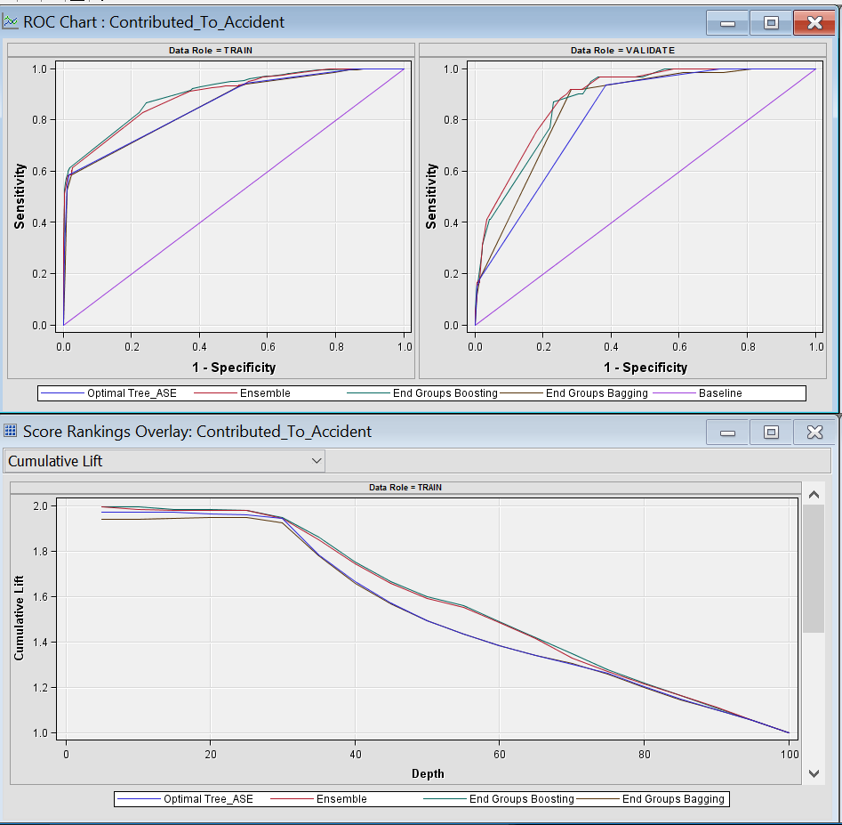
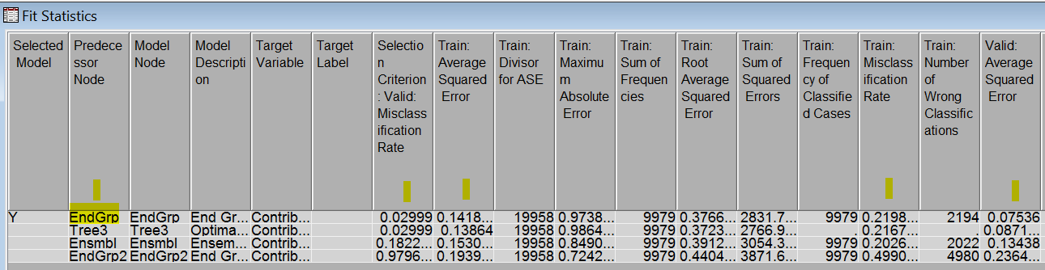
Fit Statistics and Cumulative Lift

Slide 37
Managerial implications/conclusions
Predicting the occurrence of an accident and enforcing the preventive measures is a dramatic feet of statistical application
18.03% of Accidents occur when Car Model is CIVIC, COROLLA, SONATA, CAMRY and will also result in property damage
72% of Accidents occur when the driver did not wear the seat belt, is driving a car of Mitsubishi, Chrysler company and does not have Commercial License
On a given day, accidents occur almost one and half times more post 4 pm than before it

Slide 38


